Slide 1
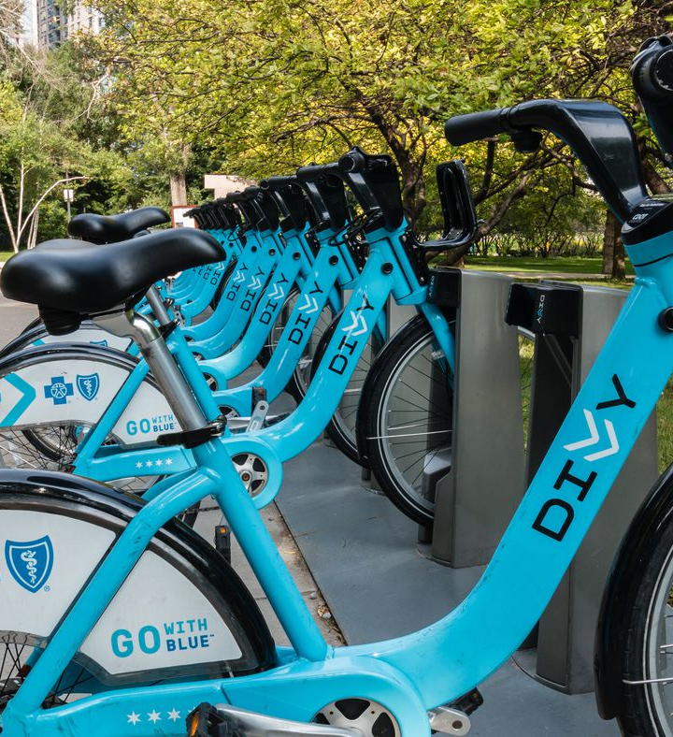
Cyclistic Bike-Sharing Usage Analysis: Insights and Recommendations
Understanding Casual vs. Annual Member Behavior
Completion Date: 3/11/2025
Data Date: 2024 (Q1,Q2,Q3,Q4) - 2025 (Q1)
Author: Hasan Hejleh

Slide 2
Table of Contents
Title —--------------------------------------------------------------------------------------------------------------------------------------------------------> 1
Table of Contents —----------------------------------------------------------------------------------------------------------------------------------> 2
About the Dataset —---------------------------------------------------------------------------------------------------------------------------------> 3
Our Stakeholders —----------------------------------------------------------------------------------------------------------------------------------> 4
Business Questions / Business Case —--------------------------------------------------------------------------------------------------> 5
Hypothesis —------------------------------------------------------------------------------------------------------------------------------------------> 6
Things To Remember —--------------------------------------------------------------------------------------------------------------------------> 7
Visualization 1: Trips count for each membership type & bike type —---------------------------------------------------> 8
Visualization 2: Trips Distribution by duration in minutes —------------------------------------------------------------------> 9
Visualization 3: Trips Distribution by hour of the day —------------------------------------------------------------------------> 10
Visualization 4: Trips Distribution by day of the week —-----------------------------------------------------------------------> 11
Visualization 5: Average Trip Duration by membership type & bike type —------------------------------------------> 12
Visualization 6: Top 10 Busiest Stations for Annual Members —--------------------------------------------------------> 13
Visualization 7: Top 10 Busiest Stations for Casual Members —--------------------------------------------------------> 14
My Discoveries —---------------------------------------------------------------------------------------------------------------------------------> 15
Ask Questions/Answers —-------------------------------------------------------------------------------------------------------------------> 16
Hypothesis Testing: Was our hypothesis correct? —---------------------------------------------------------------------------> 17
Recommendations —---------------------------------------------------------------------------------------------------------------------------> 18
Future Work —--------------------------------------------------------------------------------------------------------------------------------------> 19
References & Tools Used —-----------------------------------------------------------------------------------------------------------------> 20
Thank You for Attending —------------------------------------------------------------------------------------------------------------------> 21

Slide 3
About The Dataset
Key Considerations:
Cyclistic is an imaginary company however the data is real and is owned by divvy bikes company. (Refer to references page for more details)
The data has been processed to remove trips that are taken by staff as they service and inspect the system; and any trips that were below 60 seconds in length (potentially false starts or users trying to re-dock a bike to ensure it was secure).
The dataset is publicly available under an open license from Motivate International Inc. It includes anonymized trip data (e.g., duration, stations, bike type, membership type) for Cyclistic, a Chicago bike-share program. The data is privacy-compliant, excluding personally identifiable information, and can be used for analysis and reporting.

Slide 4
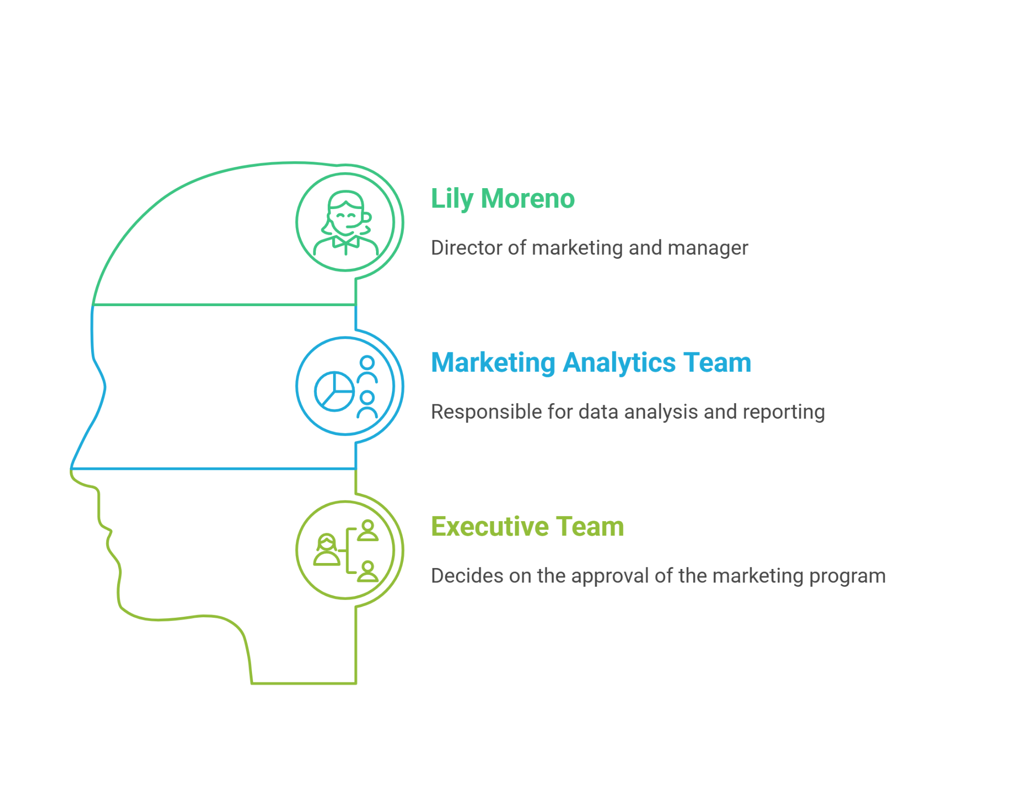
Our Stakeholders

Slide 5
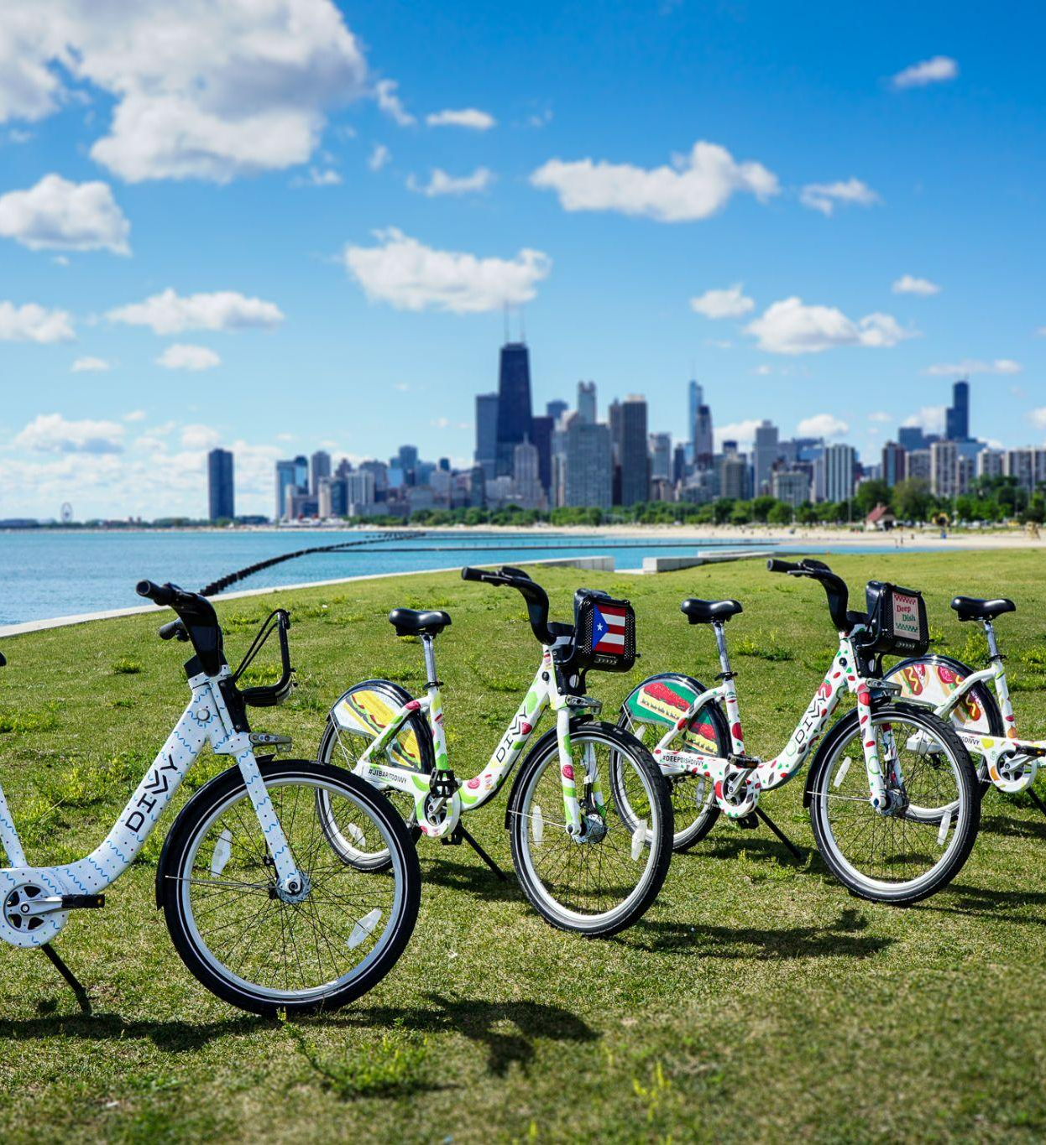
Business Questions / Business Case
Objective: Understand how casual and annual members use Cyclistic bikes differently.
Business Case: Insights will help design targeted marketing strategies to convert casual riders into annual members.
Key Questions(Ask Questions):
How do annual members and casual riders use Cyclistic bikes differently?
Why would casual riders buy Cyclistic annual memberships?
How can Cyclistic use digital media to influence casual riders to become members?

Slide 6
The hypothesis (or prediction)
Lily Moreno believes that maximizing the number of annual members will be key to future growth.
Moreno has set a clear goal Design marketing strategies aimed at converting casual riders into annual members. In order to do that, however, the team needs to better understand how annual members and casual riders differ, why casual riders would buy a membership, and how digital media could affect their marketing tactics. Moreno and her team are interested in analyzing the Cyclistic historical bike trip data to identify trends.

Slide 7
Things To Remember:
Dataset Constraints
Analysis of trip durations
Key findings & recommendations
Trips with a duration under 1.3 minutes exclusive are not included in this case study.
Membership type values (casual = casual member, member = annual member).
The values in the longitude & latitude columns produced issues when converted to distances, therefore the metric we used in this case study was the duration column by extracting it from started_at & ended_at.
Trips count for each membership type & bike type
Trips Distribution by duration in minutes
Trips Distribution by hour of the day
Trips Distribution by day of the week
Average Trip Duration by membership type & bike type
Busiest Stations for both membership types
My Discoveries
Answers to the Ask Questions
Hypothesis Proof
Recommendations
Future Work
Notes:
Sec.1
Q1) why? Because trips under 1.3 minutes are probably ones done by employees to restock bicycles or for testing purposes or an unintentional trip made by riders due to the extremely short duration and since the closest two stations owned by divvy are 200 meters apart and aren’t reachable in under 1.3 minutes even going at max speed due to the terrain of the area and traffic.

Slide 8
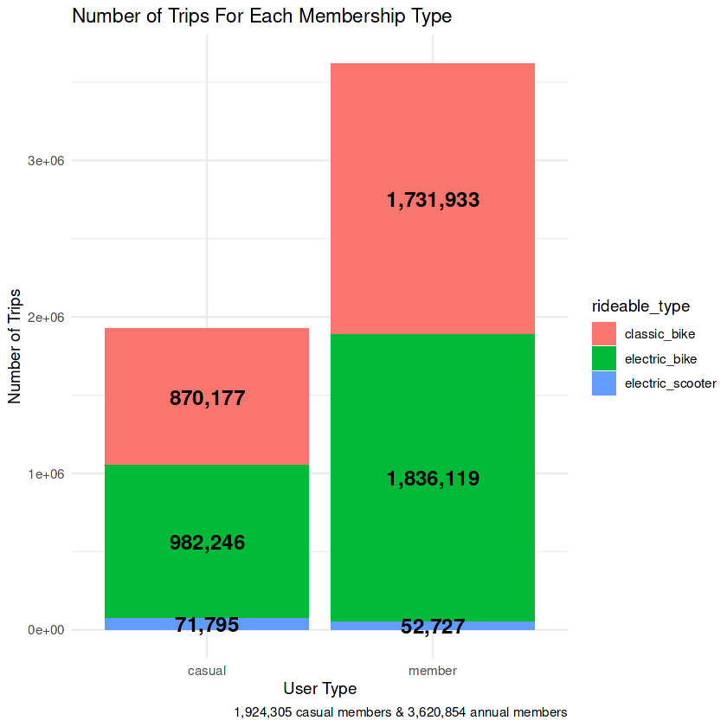
Trips count for each membership type & bike type Viz
Findings:
We have more annual members than casual members.
Riders tend to prefer Electric Bikes the most, followed by classic bikes and finally electric scooters.
Both membership riders and casual riders prefer Electric Bikes the most!

Slide 9
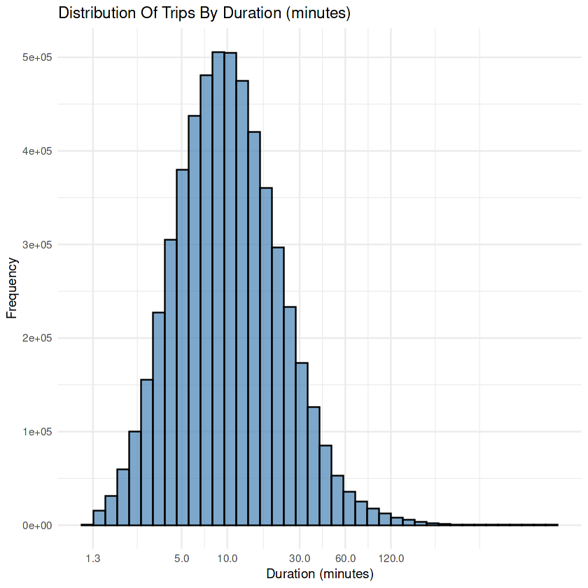
Trips Distribution by duration in minutes Viz
Findings:
Most of the trips fall between [1.3 , 30] minutes with a percentage of 91.1%
The Distribution implies that most riders have a trip duration less than 120 minutes.

Slide 10
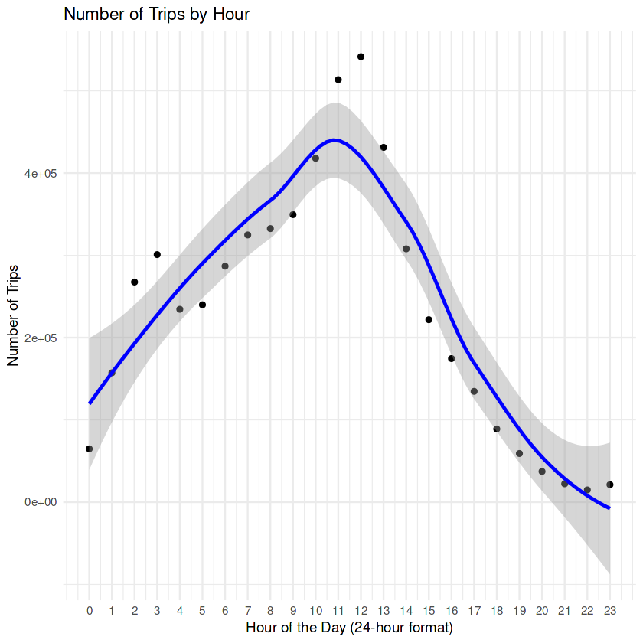
Trips Distribution by hour of the day Viz
Findings:
Trips start increasing from 4 AM, until they reach a peak around 11 AM - 1 PM, after which they continue to drop approaching a linear amount.
We notice a sudden increase in trips around 11 AM - 1 PM which should be considered a great time to focus our marketing strategies & advertisements.
During the peak, we reach an amount of 470,000 concurrent trips.

Slide 11
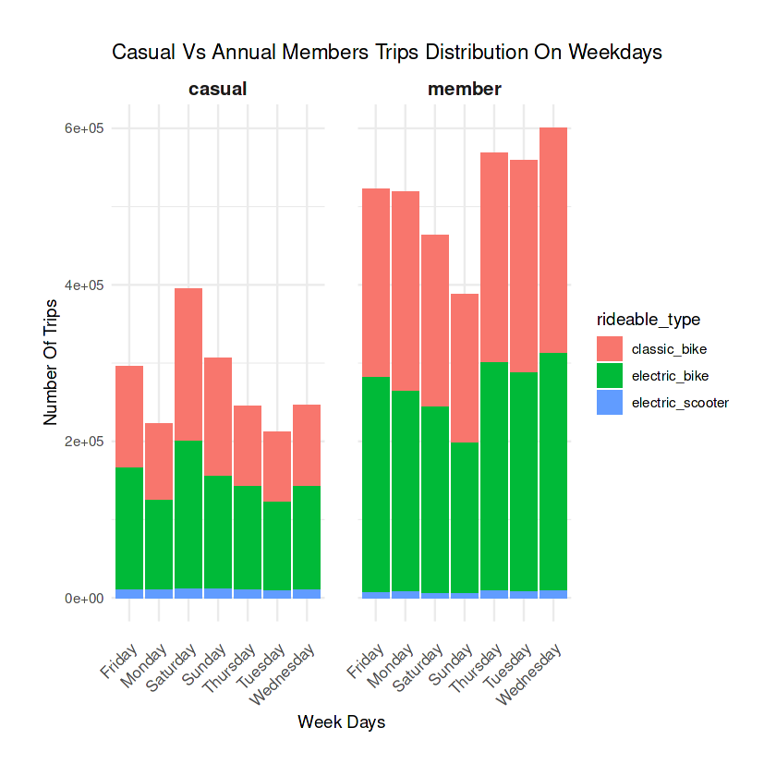
Trips Distribution by day of the week Viz
Findings:
Annual Members use our bikes the most during Business Days: Wednesday, Thursday, Tuesday
Casual Members use our bikes the most during Weekends: Saturday, Sunday, Friday
This could imply that annual members tend to use our bikes for work related purposes, while casual members could be using them for leisure & sports

Slide 12
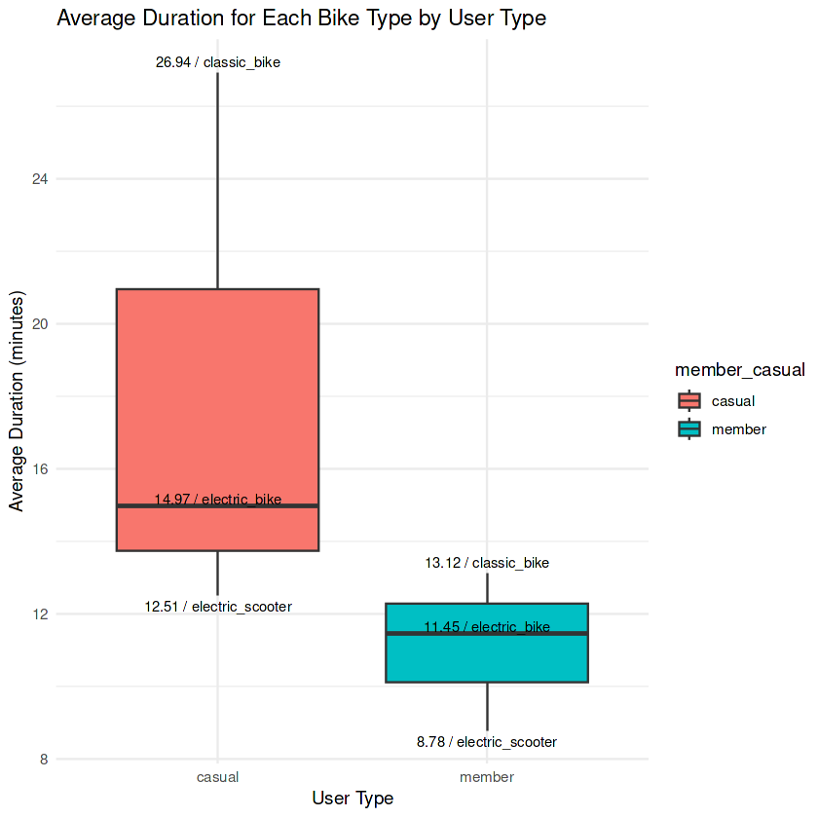
Average Trip Duration by membership type & bike type
Viz
Findings:
Annual Members tend to have a shorter trip on average than casual members regardless of the bike type
Casual Members tend to have longer trips on average
This strengthens our previous intuition that annual members could be using our bikes for work related purposes, while casual members could be using them for leisure & sports

Slide 13
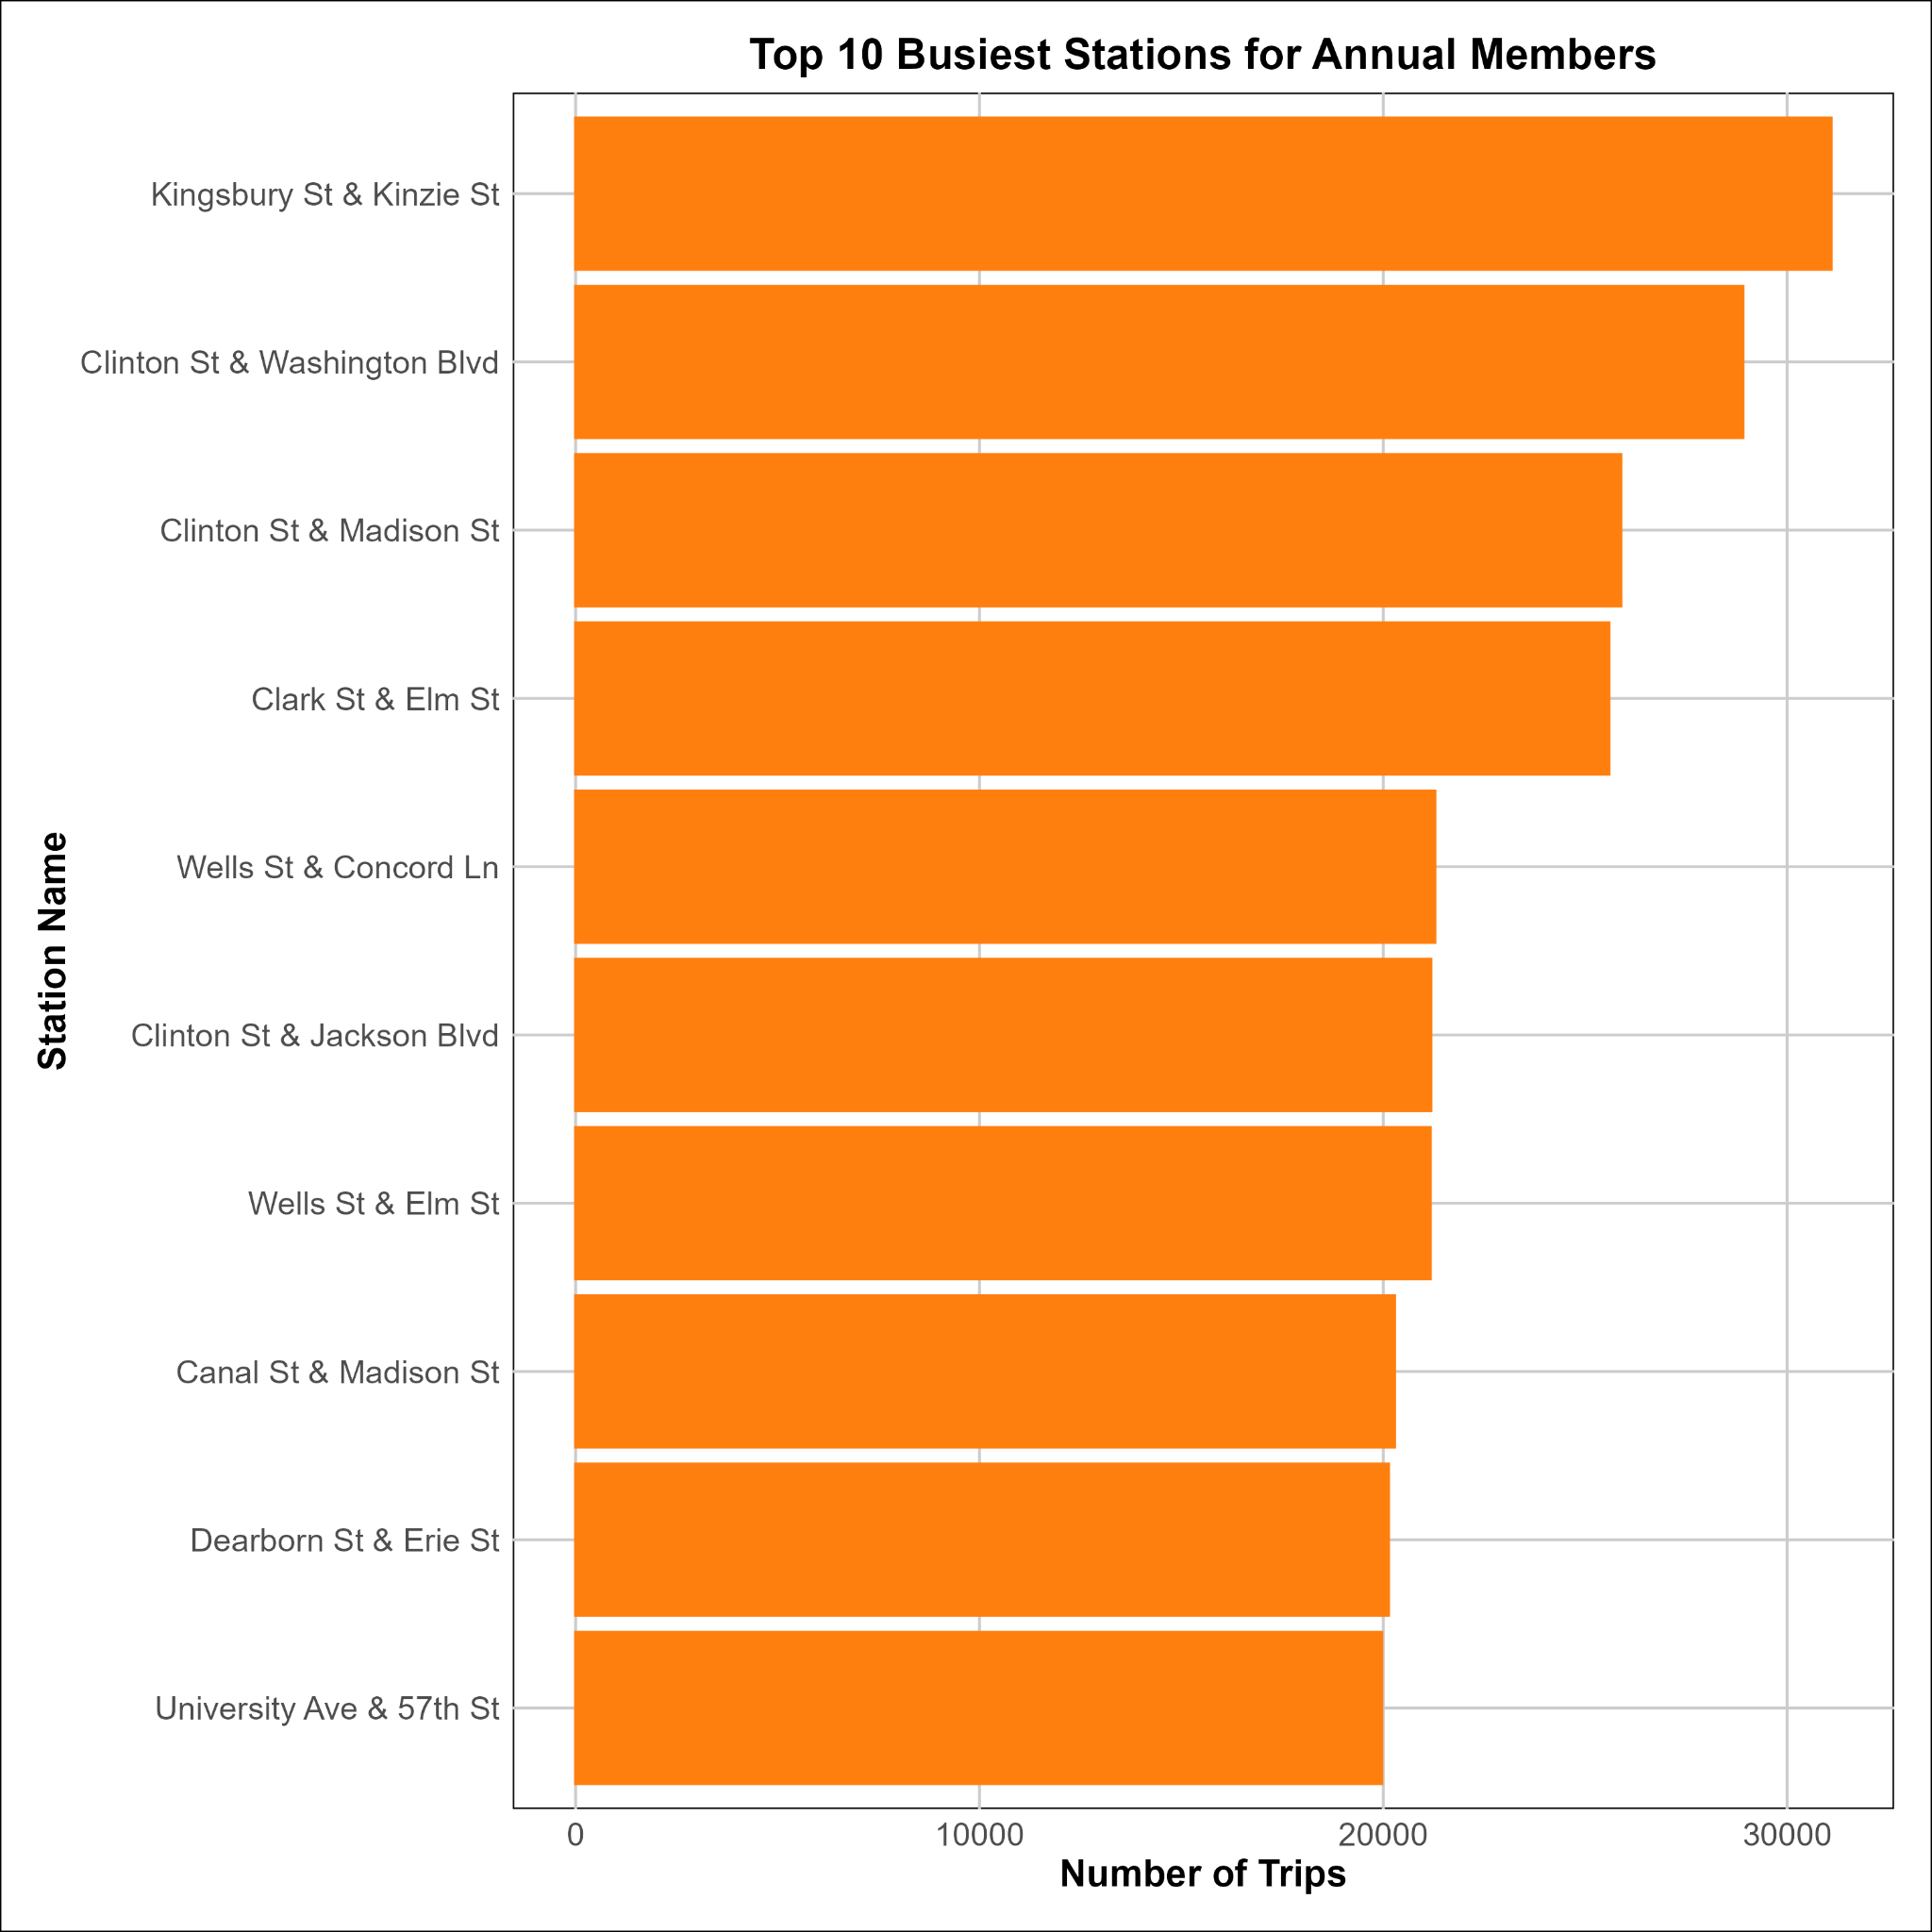
Top 10 Busiest Stations for Annual Members
Viz
Shared Findings:
Most of the stations are located in or near commercial districts, business hubs, or areas with high foot traffic (e.g., West Loop, River North, Chicago Loop).
This suggests that annual members (likely commuters) frequently use these stations to travel to and from work or other business-related activities.

Slide 14
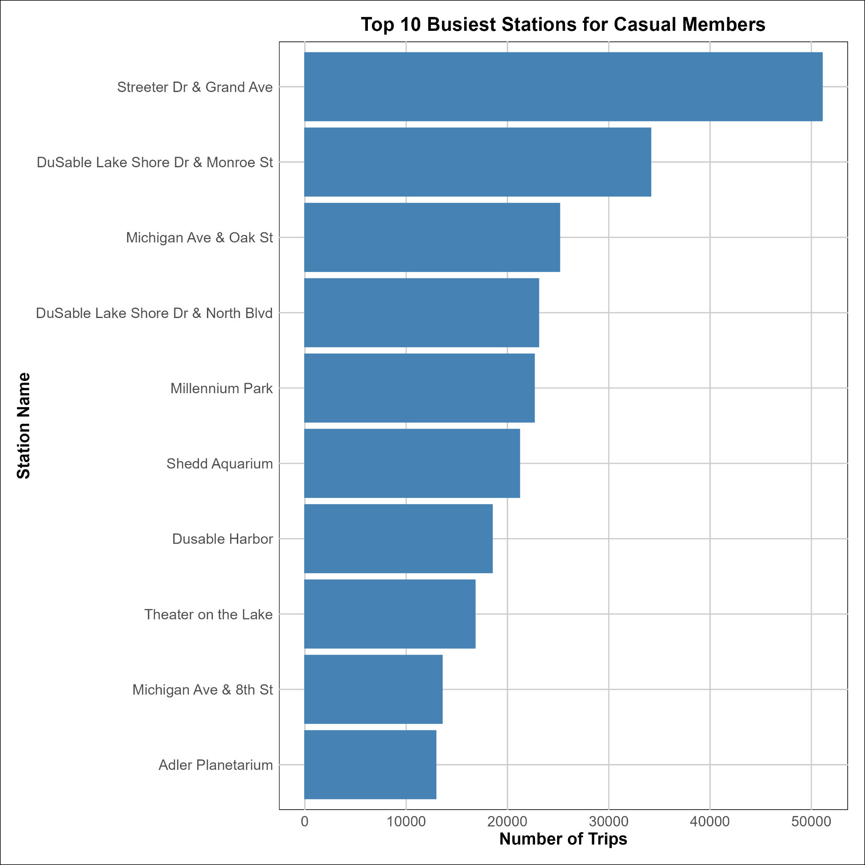
Top 10 Busiest Stations for Casual Members
Viz
Shared Findings:
The majority of these stations are located near tourist attractions, parks, and recreational areas, indicating that casual members are likely using the bike-sharing service for sightseeing and leisure activities.
Shared Stations such as Wells St & Concord Ln can be used to focus marketing strategies while using a system of rewards to display the benefits of annual memberships, we can also hold events are these stations where annual members & casual members could meet up and exchange their thoughts.

Slide 15



Aha! My Discoveries
Over 90% of trips have a duration less than 30 minutes.
Trips reach a peak at late morning/midday hours.
Annual members use our bikes for work related purposes, while casual members use them for leisure.

Slide 16
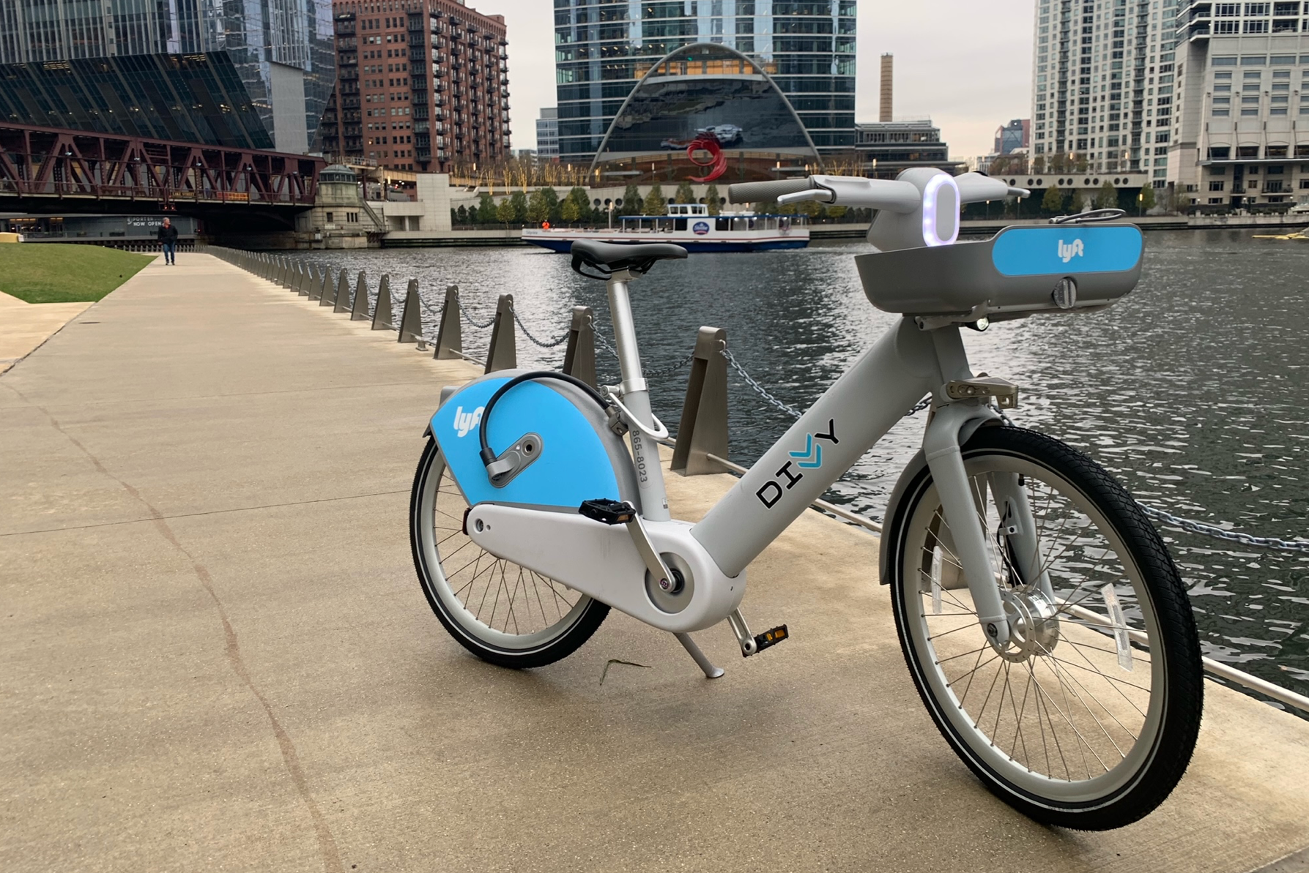
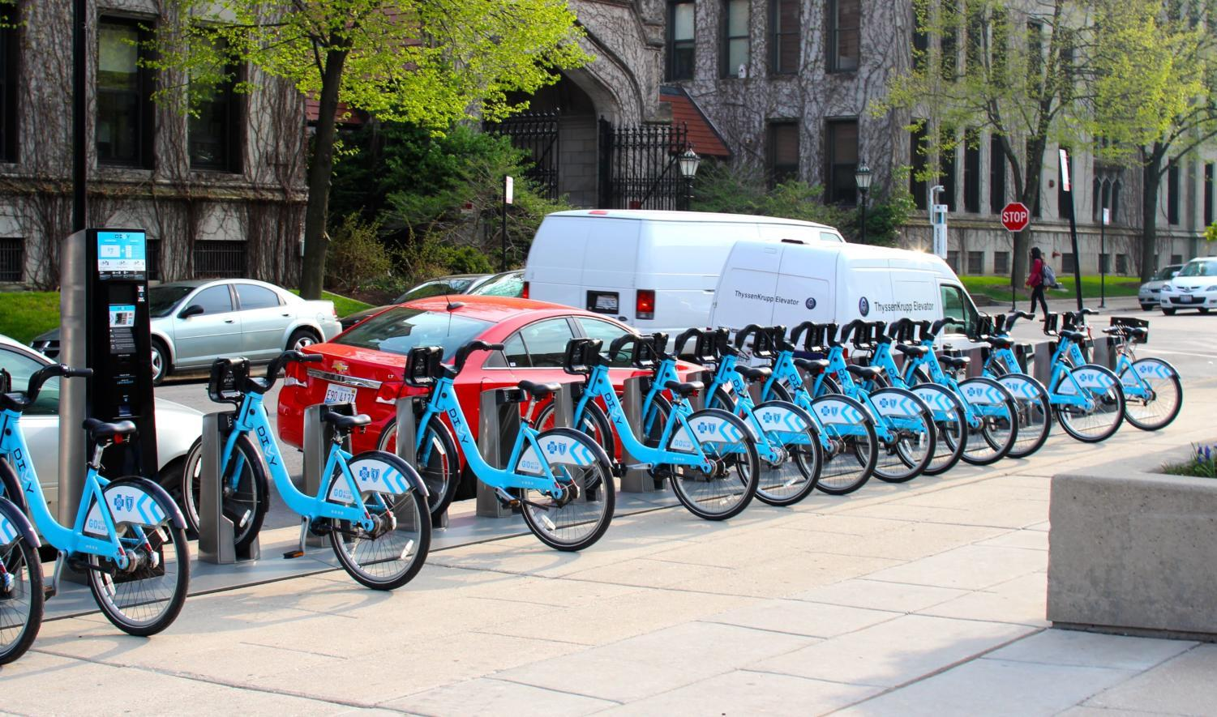
Ask Questions/Answers
How do annual members and casual riders use Cyclistic bikes differently?
Annual members use bikes for commuting, with short weekday trips starting from business areas. Casual riders use them for leisure, with longer weekend trips starting near tourist spots & parks.
Why would casual riders buy Cyclistic annual memberships?
Casual riders might buy annual memberships to save money if they use the service frequently, enjoy the convenience of unlimited rides, or access exclusive perks like discounts at local attractions or priority bike access during peak times.
How can Cyclistic use digital media to influence casual riders to become members?
Cyclistic can use targeted social media ads displaying the variety of bike types available, hosting events & marathons with rewards, and in-app promotions to highlight the benefits of annual memberships.

Slide 17
Was our hypothesis correct?
Hypothesis: Lily Moreno believes that maximizing the number of annual members will be key to future growth.
Answer:
maximizing the number of annual members is the correct course of action for Cyclistic's future growth. Annual members provide consistent revenue, higher usage frequency, and predictable ridership patterns, which are crucial for operational planning and scalability. Additionally, converting casual riders—who already show interest in the service—into annual members can further increase customer loyalty and reduce marketing costs over time. This strategy aligns with the data showing that annual members use bikes more regularly and for shorter, commuter-focused trips, making them a more stable and profitable user base compared to casual riders.

Slide 18
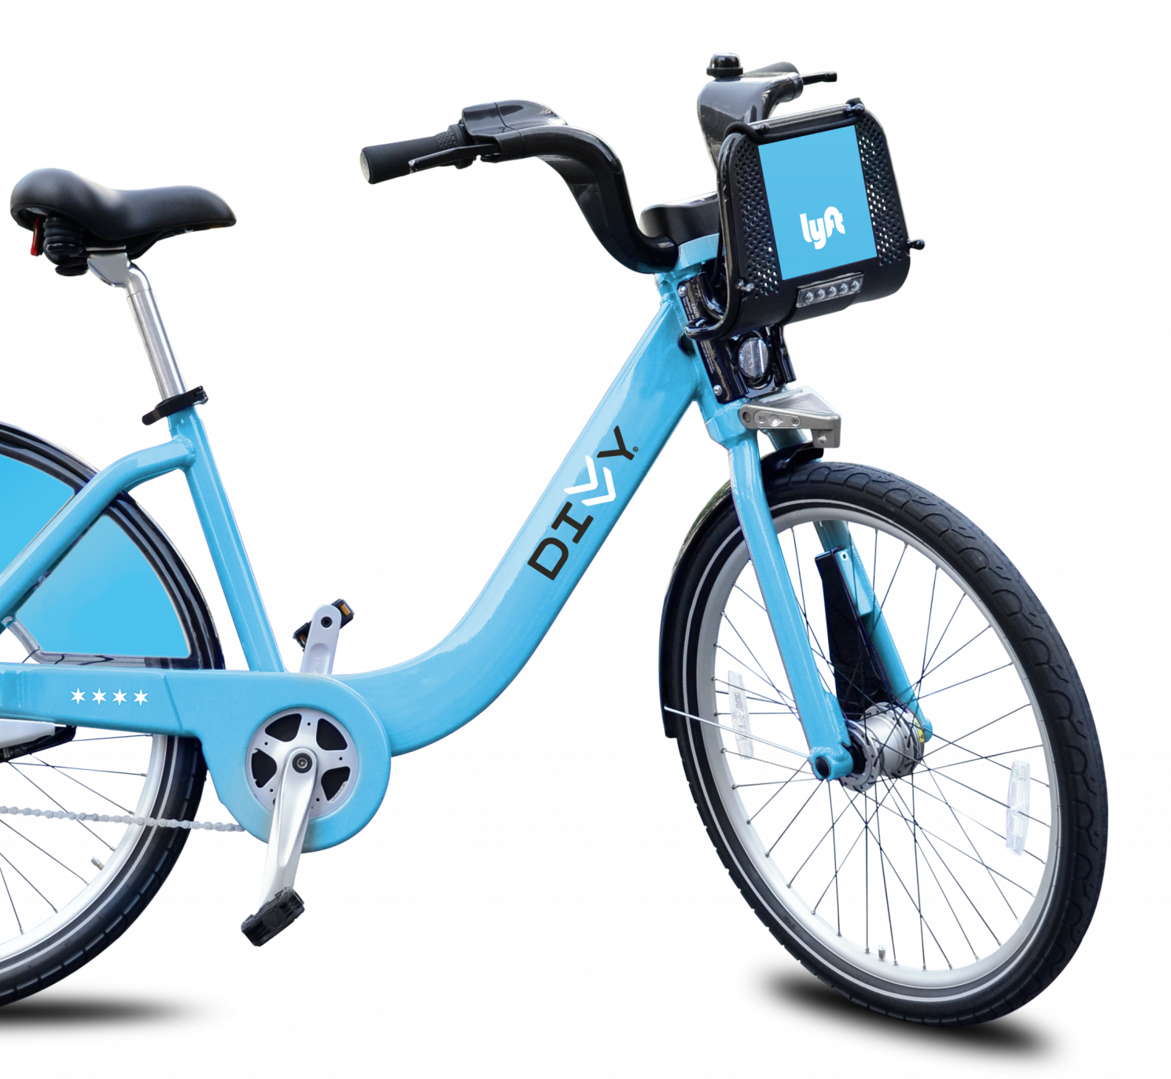
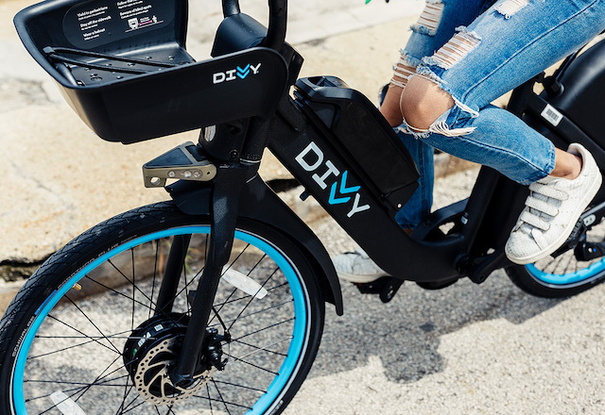
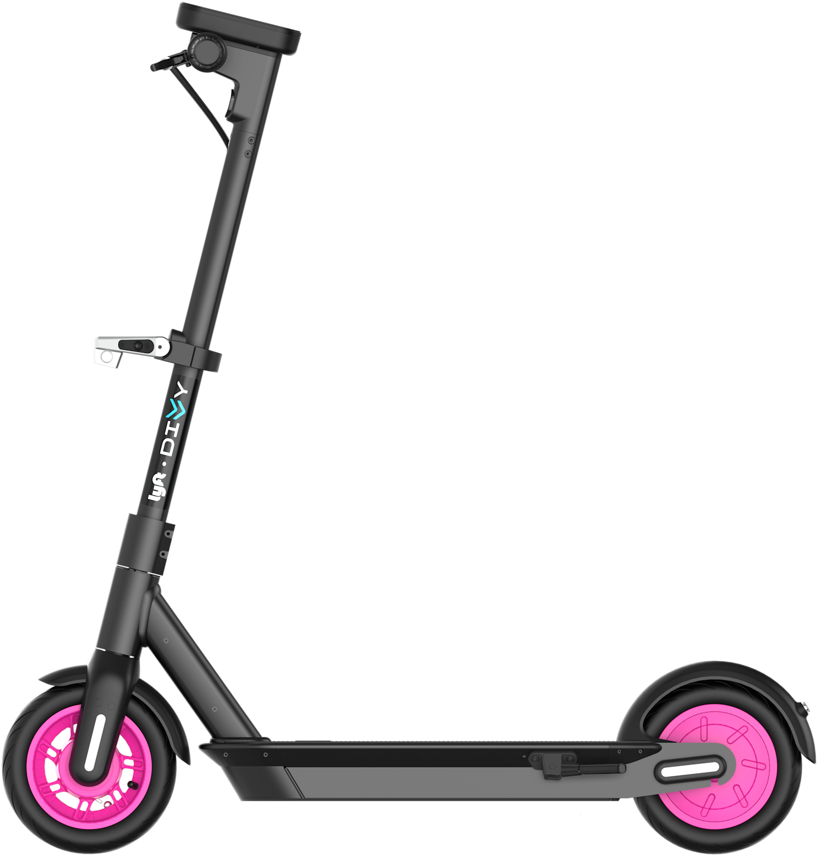
Time to Act! Recommendations
To convert casual riders into annual members, Cyclistic could target marketing campaigns at popular casual stations, emphasizing the cost savings and convenience of memberships for both leisure and commuting purposes.
Additionally, improving bike availability and docking infrastructure at these high-traffic casual stations could enhance the user experience and encourage membership conversions.
Finally, the advertisements should showcase the different bike types available at hand while focussing on the most popular electronic bikes.

Slide 19
Future Work
What is next?
Collect and analyze demographic data (e.g., age, gender, income)
Conduct surveys or use data to determine the primary purpose of trips (e.g., commuting, leisure, errands)
Study why some casual riders do not convert to annual members and identify strategies to improve retention and reduce churn.
Compare Cyclistic’s performance & membership with competitors in the bike-sharing market to identify areas for improvement and differentiation.
Collect and analyze user feedback to identify pain points, preferences, and areas for improvement in the service.
User Demographics.
Trip Purpose Analysis.
Customer Retention and Churn Analysis.
Competitor Analysis.
User Feedback Analysis.

Slide 20


References/Sources
Tools Used
Data Source & License.
Kaggle Notebook.
R Programming Language: used for statistical analysis & visualization
Kaggle Notebook: for documentation & version history control.
R Markdown: for R code documentation

Slide 21

THANK
YOU
For Attending

